Slide 1
1000 pts – 2d

Slide 2
5000 pts – 2-d

Slide 3
1000 pts – 6-d

Slide 4
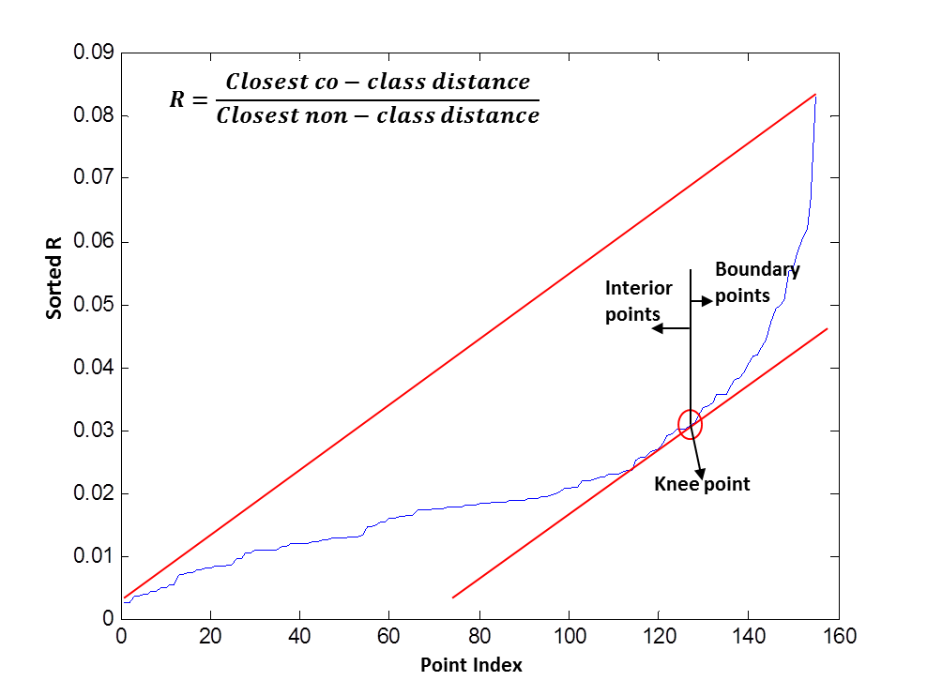
Experiments with Data Economy
Full Data (2000 points)
Boundary determination using distance ratio R with Optimal Metric
Optimal metric from full data
Boundary (281 points) From Knee
(see plot on right)
Using only boundary points (~14%) produces metric close to using full data in this example
Provides data economy and prioritization
Optimal metric from boundary points

